Slide 1
Online News Popularity
Analysis and Prediction​
Group 16
Abhijit Kannepalli, Bhavesh Chatnani, Hemil Kothari,
Saurabh Saoji, Shrey Shah

Slide 2
Introduction
With the advent of the internet and social media, online news has become integral to everyone’s life.
The most significant increase in attention paid to a specific news piece is known as news popularity.

Slide 3
Literature Review
Omar (2007) talks about the transition from conventional to online news and factors that contributed to online news becoming popular. Immediacy and polarity plays a key role for a news category to spread faster than others.
Shirsat et al. (2017) estimated the polarity of words (positive, negative, neutral). The articles were divided into genre groups as positive, negative, or neutral.
Deshpande (2017) studied the dimensionality reduction techniques, compared different models and identified the optimal model to predict web news popularity.

Slide 4
Research Question 1
Which factors are critical in determining the popularity of online news in terms of its shares?

Slide 5
Application
Whether a news is popular or not is dependent on a wide array of features
Analysing all of them together can be complex. What if we can identify the significant factors that should be considered for identifying popular news articles?
The reduced feature set can be used in further analysis like:
predicting the shares of the news articles
Bloggers and social media content creators can understand what type of articles gain more popularity
News/Text mining can be performed based on article content and self reference shares to other articles of the same type to find relationships between articles

Slide 6
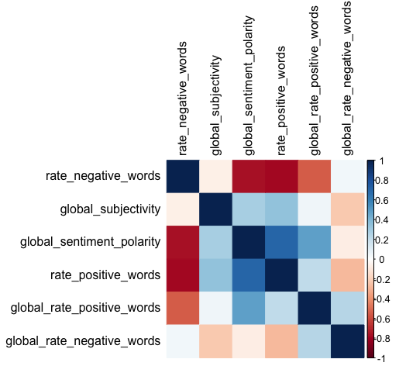
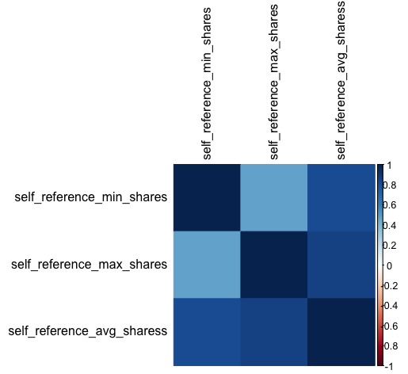
Quick Visualizations

Slide 7
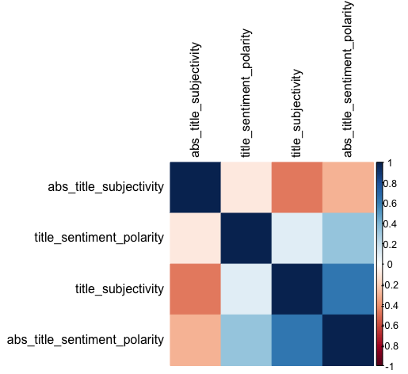
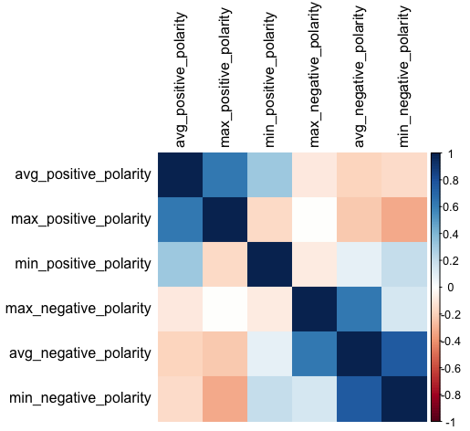

Slide 8
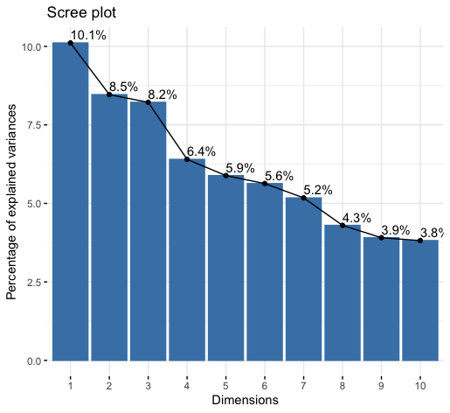
Number of components = 5

Slide 9
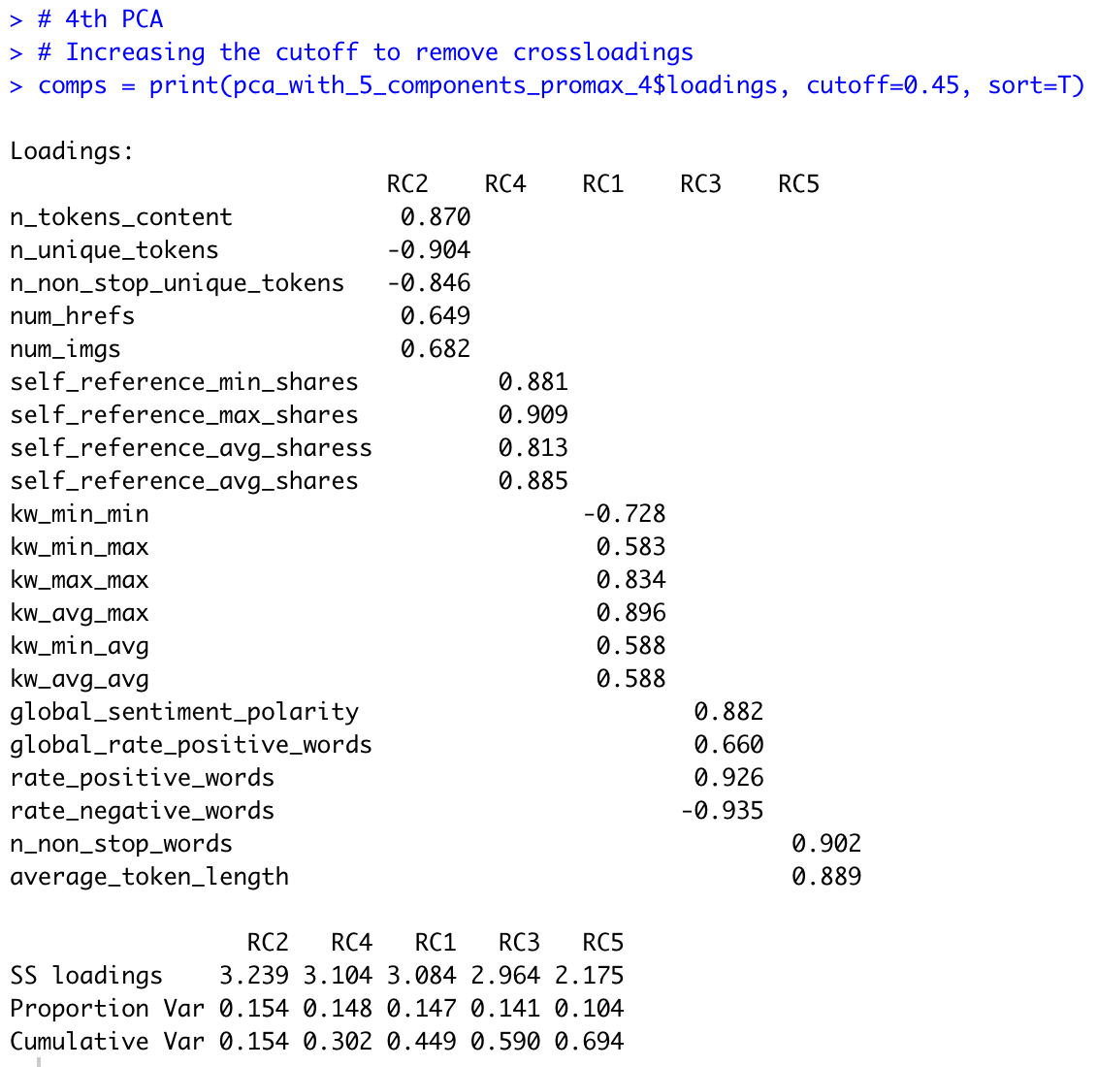
Analysis & Discussion
Is it significant?
KMO test has a value of 0.5
Bartlett’s Test: 12926832 (df = 44, p < 0.001)
Cronbach’s Alpha = 0.53

Slide 10
Interpretation of Principal Components
PC2: Number of Tokens, Images and Links – Number of unique, content and non-stop tokens, images and links present in articles
PC4: Self Reference Shares – Shares of articles when it refers/links to other articles of similar type
PC1: Keyword Based Shares – Shares of articles based on the best, worst and average keywords
PC3: Positive Content News – Positive sentiment polarity, the proportion of positive and negative words
PC5: Non-Stop Words and Token Length – Average length of tokens and the amount of non-stop words

Slide 11
Research Question 2
Predicting if an article is popular or not?

Slide 12
Application
Predicting the popularity based on specific attributes of an article would help publishers improve those aspects for better reach.
By analyzing the type of polarity in the popular articles, news agencies or content writers could mold their articles in that direction.

Slide 13
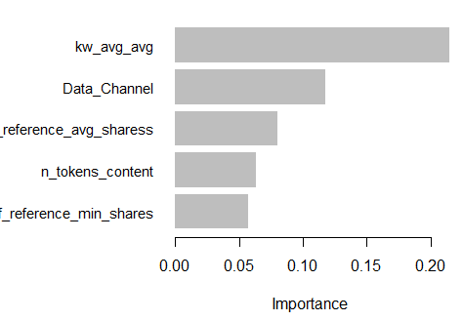

Method and Outcome
XGBoost to predict the binary output variable - Popular / Not popular (Threshold: 2000)
Summary of outcome:
Accuracy: 71%
Sensitivity: 73%
Specificity: 63%
Here ‘0’ represents the class of unpopular articles
Significant features in determining the popularity

Slide 14
Research Question 3
Do authors prefer to write polarizing articles?

Slide 15
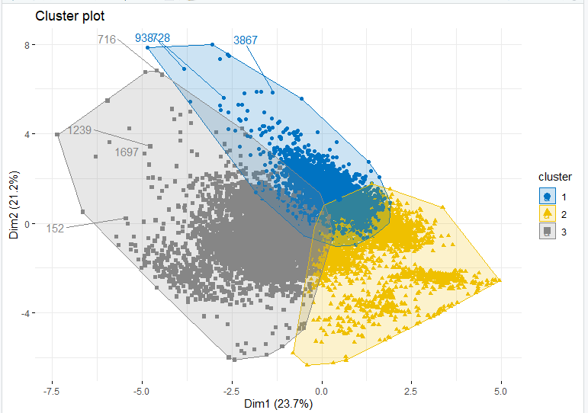
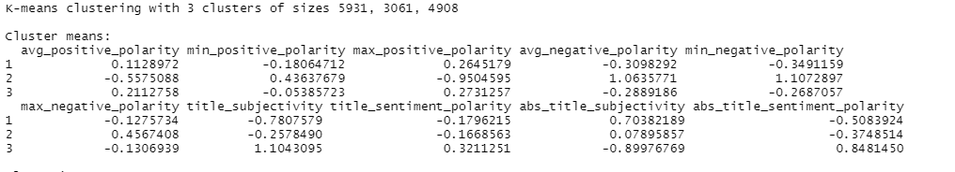
Methods and Outcome
Used K-means clustering technique
Articles were split into 3 clusters:
Positive
Negative
Neutral
Around 78% percent of the articles were either positive or negative.

Slide 16
Research Question 4
Is the popularity of an article dependent on the data channel publishing it?

Slide 17
https://drive.google.com/file/d/1heCxqHvbr0oCvaUi0fmhmfrlVblOZpur/view

Slide 18
Application
Understanding the significance of data channels can help us understand if the category of an article, ie, business, technology etc. is a contributing factor to the popularity
This can also allow us to analyze the readers of the article as to which category of news are they are more likely to read and share.

Slide 19
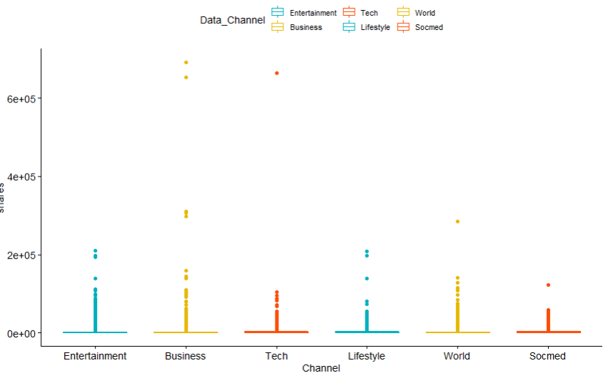

Methods and Outcome
Original data channel columns were pre-processed to form one single column forming categorical attributes
Data is non-normal, hence Kruskal-Wallis test was used
P-value < 0.001 suggests that null hypothesis is rejected, and data channel of article does not influence the popularity
Thus we conclude that the data channel an article belongs to does not influence the popularity of the article

Slide 20
Research Question 5
Is the popularity of an article dependent on the day of the week it is published on?

Slide 21
https://drive.google.com/file/d/1AR8mUgFZ-6Q3qJC7FPtXSPcPj2dOCirB/view

Slide 22
Applications
Predicting the popularity based on the day of the article being published can be an important factor to consider
This will help us understand if people specifically prefer to watch/read news on weekends (when one is relatively free) or weekdays.

Slide 23
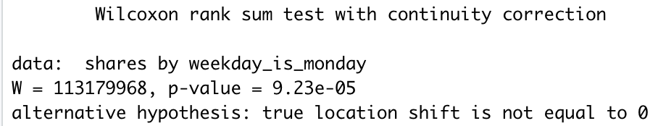
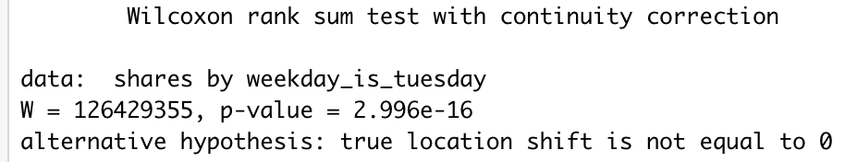
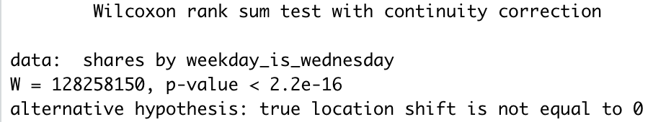
Methods and Outcome
Used Mann-Whitney U Test algorithm.
P-value for all of the days: <0.05
All p-values are less than 0.05, and hence there is no association between the day of week when article was published and the popularity of a news article.
Similarly, for the rest of the days, the p-value is still below 0.05.

Slide 24
Limitations
We can represent approximately same amount of information with less data. The trade-off here, is that it does not always guarantee the interpretability of the components.
Popularity is subjective. In our research, we took a threshold of 2000 for the number of shares to be popular.
Due to cluster overlap, sentiment in many articles is not clearly determined.
This research has not achieved predictions based on the news article’s polarity.

Slide 25
Future Work
In the future, we can focus on working on even larger datasets which can also include actual words present in the article, to help us improve the factors determining popularity.
We would also like to try to understand why factors like data channel and time of article being published is not relevant when studying the data but are important when used to predict the popularity using our model.

Slide 26
Conclusion
The major factors which can be used to determine online news popularity are based on token proportion, reference to similar articles, keyword based shares, the proportion of positive content and token lengths.
The grouping of articles based on the positive, negative or neutral sentiments can be helpful in understanding the mindset of authors.
The popularity prediction and the factors can be used to understand the article content for gaining maximum traction.
It is observed that article popularity does not depend on the genre or when the article is read indicating.

Slide 27
References
Deshpande, D. (2017). Prediction & Evaluation of online news popularity using Machine Intelligence. 2017 International Conference on Computing, Communication, Control and Automation (ICCUBEA). https://doi.org/10.1109/iccubea.2017.8463790
Omar, B. (2007). The Switch to Online Newspapers Could Immediacy Be a Factor?
Shirsat, V. S., Jagdale, R. S., & Deshmukh, S. N. (2017). Document level sentiment analysis from news articles. 2017 International Conference on Computing, Communication, Control and Automation (ICCUBEA). https://doi.org/10.1109/iccubea.2017.8463638

Slide 28
THANK YOU

